Slide 1
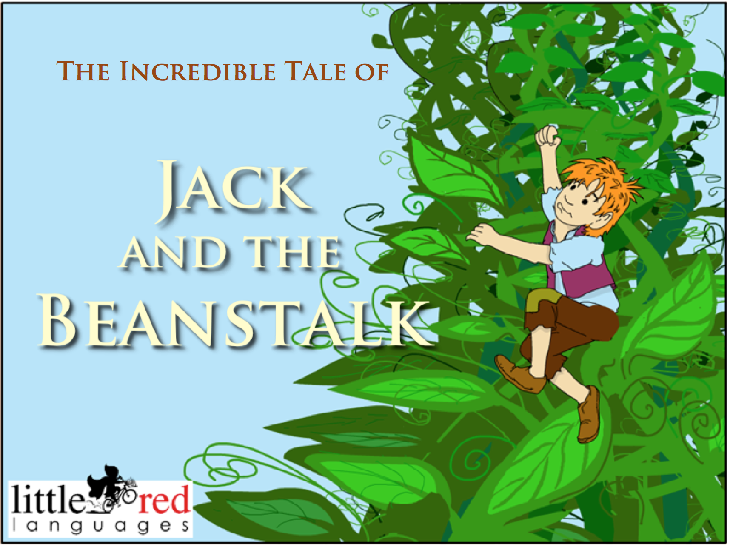


Slide 2
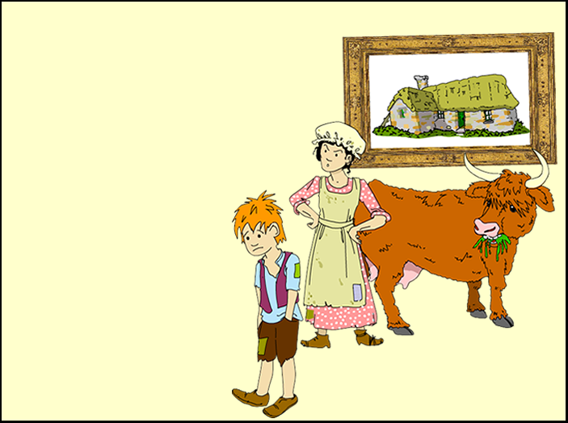
This story starts with Jack.
Here he is.
He is miserable.
And here is his mother.
She is angry.
And this is their house.
It is falling down.
And this is their cow.
She seems OK.
And that's all they have.
So far.....
This story starts with Jack.
Here he is.
He is miserable.
And here is his mother.
She is angry.
And this is their house.
It is falling down.
And this is their cow.
She seems OK.
And that's all they have.
So far.....

Slide 3
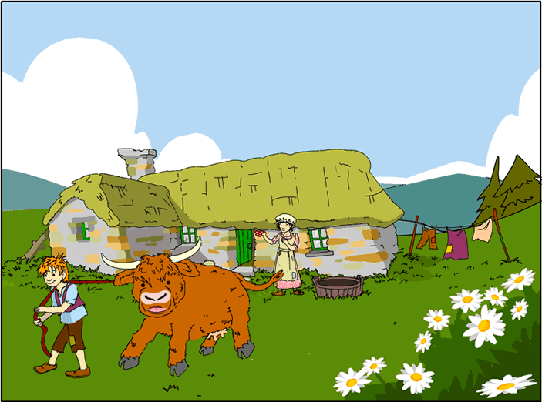

Jack lived with his mother in an old, tumbledown cottage.
They were very poor.
All they had was a cow called Ginger.
They sold Ginger's milk to buy food but it wasn't enough.
They had to sell Ginger.
One morning, Jack set off with the cow to the market in the town.

Slide 4
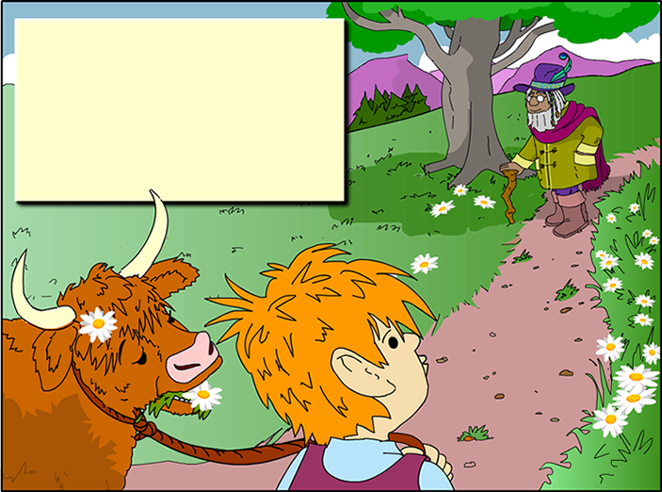
Jack whistled as he walked.
The cow just mooed.
Then Jack stopped whistling.
An old man was hobbling
along the road towards him.

Slide 5
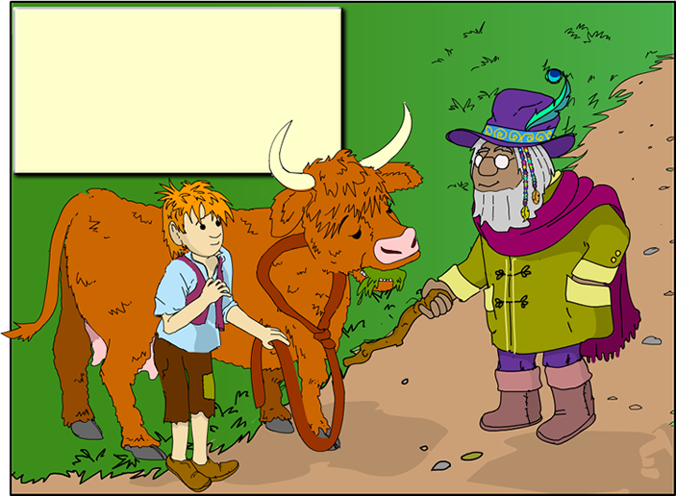
Jack bowed. "Good morning, sir."
The old man smiled at Jack and
he looked at the cow.
"I'll buy your cow," he said.

Slide 6
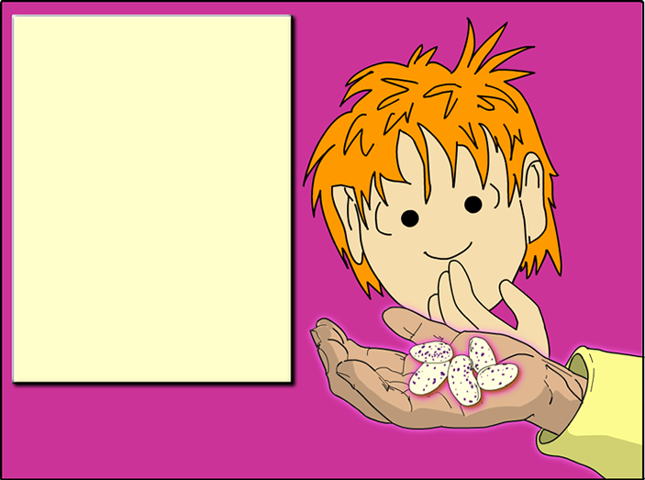
Jack was amazed!
The old man spoke again.
"For this cow, Jack, I will give you FIVE magic beans."
Jack looked at the beans. They certainly looked magical!
He took the beans and handed the cow's rope
to the old man.

Slide 7

What happened next?
This is just a preview of the story - there are another 27 scenes to enjoy!
Subscribe now to access the full PowerPoint file as well as the fully animated Flash version.
www.littleredlanguages.co.uk

